Slide 1


Slide 2

Topic Name: Theory of Set
Presented by:
.
Afsana kabir sinthia
Id:182002068
.
Razia sultana urmi
Id:182002079
.
Fahima aktar urmi
Id:182002097
Presented to:
Ahmed pritom
Lecturar (Discrete Math)

Slide 3

Content
Definition of set
Set operation
Different types of sets
Empty set
Subset
Proper subset
Finite set
Universal set
Power set
Set operation

Slide 4

What is Set???
The theory of sets was developed by German mathematician Georg Cantor (1845-1918).
A set is a well defined collection of objects.
These objects are called elements or members of the set.
Sets are denoted by Capital letters
Sets use “curly” brackets
A = {a, b, 1, 2}
b is an element of A

Slide 5
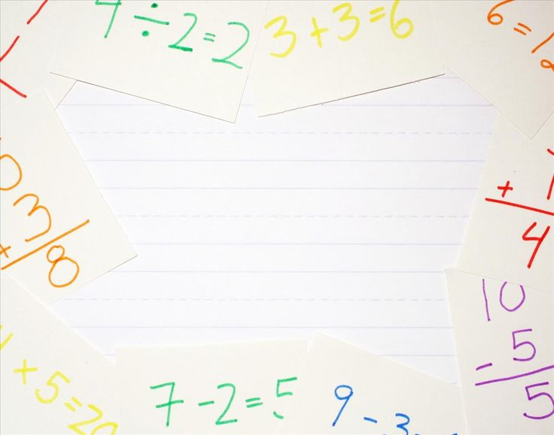
Some of common sets
N = The set of natural numbers .
R = The set of real number .
C = The set of complex number.
Z = The set of integers
Q = The set of Rational numbers .
P = The set of prime numbers.
E = The set of even integers.
O = The set of odd integers.

Slide 6

Different types of set
set
Sub set
Finite set
Universal set
Empty set
Power set
Proper set

Slide 7
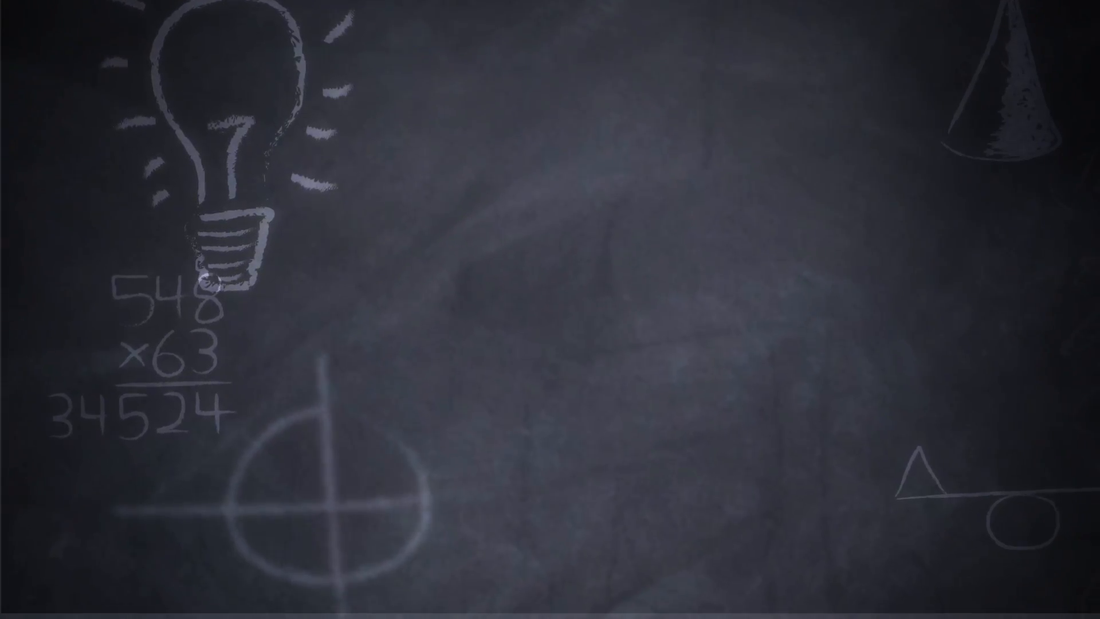
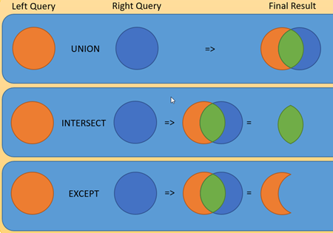
Basic operations set theory
A B AUB
A B A∩B
A B A/B
A
B

Slide 8
Empty set
If a set doesn't contain any elements it is called the empty set or the null set. It is denoted by ∅ or { }.
Example
The set of prime numbers greater then 2 is the empty set.
Example 2:
A = {1,2,3,4}
B = {a,b,c}
A ∩ B = { } or Ф

Slide 9
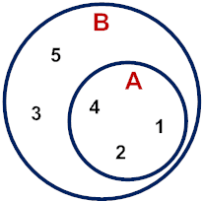
Sub set
A set is considered sub set of B if all the elements found in A are in B.
Sub set denoted by A ⊆ B
Example 1: A={2 ,4 ,1}
B={5,3,2,4,1}
where A ⊆ B
Example : 2
P ={a,b,c}
Q ={a,b,c}
Where P ⊆ Q
P
Q
a b c

Slide 10
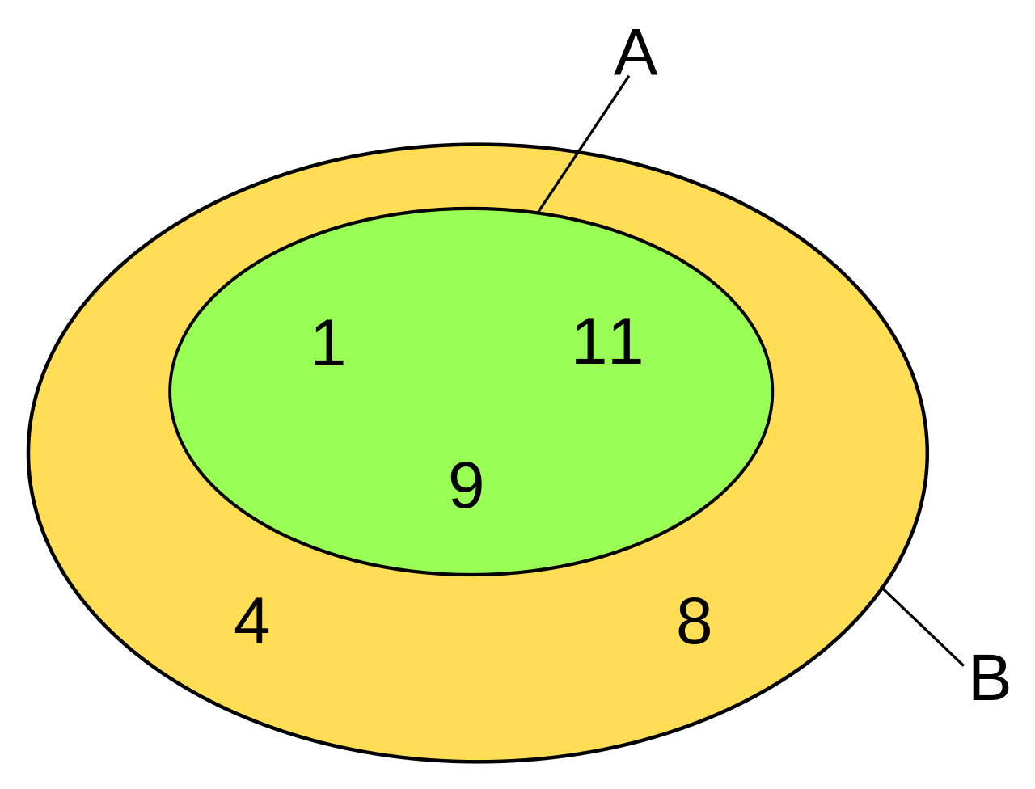
Proper subset
N is a proper subset of M if all elements of N belong to set M and there exist at least one element in M such that it does not belong to N. It denoted by N⊂ M
Example
A={ 1,11,9}
B={ 1, 11, 9,4,8}
A ⊂ B

Slide 11
Finite set
In mathematics, a finite set is a set that has a finite number of elements. Informally, a finite set is a set which one could in principle count and finish counting.
Example
A = { a,b,c,d}
Here is a finite set because we can count element of a A.
Element of a is 4

Slide 12
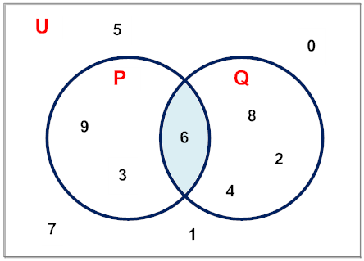
Universal set
A universal set is a set which contains all objects, including itself.
There is no standard notation for the universal set of a given set theory. Common symbols include V, U Example
P ={9,6,3}
Q={6,8,4,2}
Others ={7,5,1}
Here the universal set is
U={1,2,3,4,5,6,7,8,9}

Slide 13
Power set
A Power Set is a set of all the subsets of a set.
For the set {a,b,c}:
The empty set {} is a subset of {a,b,c}
And these are subsets: {a}, {b} and {c}
And these are also subsets: {a,b}, {a,c} and {b,c}
And {a,b,c} is a subset of {a,b,c}
And altogether we get the Power Set of {a,b,c}:
P(S) = { {}, {a}, {b}, {c}, {a, b}, {a, c}, {b, c}, {a, b, c} }

Slide 14

Any question ??

